Slide 1
Phylum Arthropoda - Subphylum Crustacea - Class Malacostraca
Order:Decapods

Slide 2
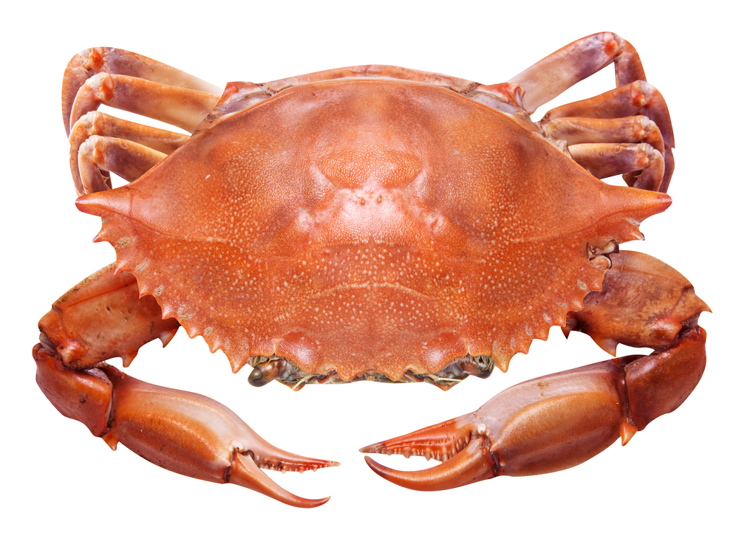
Legs
Carapace
Chelipeds
Antenna
Antennule
Mouth parts

